Slide 1
Using Your Protractor
Mr. Murphy – Grade 6 Math

Slide 2
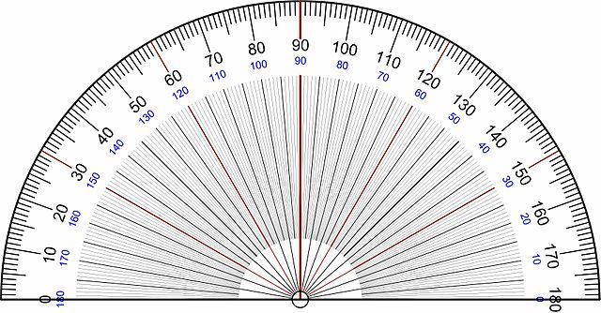
Reading Protractors
There are four different pieces to a protractor:
The Centre
The Base Line
The Inner Scale
The Outer Scale
Outer Scale
Inner Scale
Base Line
Centre

Slide 3
Reading Protractors: Inner Scale

Slide 4
Reading Protractors
There are four different pieces to a protractor:
The Centre
The Base Line
The Inner Scale
The Outer Scale
Outer Scale
Inner Scale
Base Line
Centre

Slide 5
Reading Protractors: Outer Scale

Slide 6
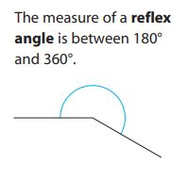
What about angles greater than 180°?
We know that a Reflex Angle is greater than a Straight Angle
Since this is the case, a Reflex Angle is any angle that is between 180° and 360°

Slide 7
Using protractors to measure Reflex angles
We first measure the angle less than 180° that is created when we have a Reflex Angle
Use the same techniques for lining up the protractor as we have already been doing
Subtract our measure from 360° to get the measure for the Reflex Angle

Slide 8
Using protractors to measure Reflex angles
Using the inner scale, we measure 43°
We then subtract this from 360° to obtain a measure for the reflex angle of 317°

Slide 9
Using protractors to measure Reflex angles
Using the outer scale, we measure 125°
We then subtract this from 360° to obtain a measure for the reflex angle of 235°

