Slide 1
Measuring Angles
Mr. Murphy – Grade 6 Math

Slide 2
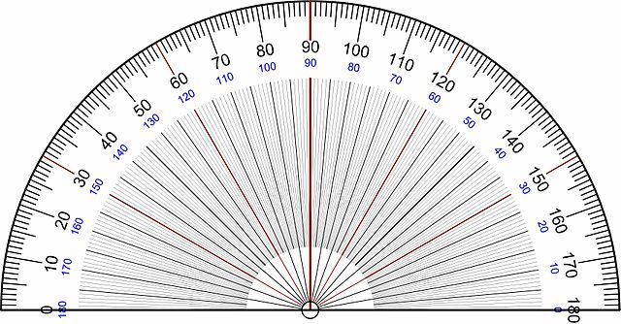
How do we measure an angle?
We measure an Angle using a Protractor
Key Words:
Protractor: A Protractor is a tool that measures an angle. It is divided into 180 equal slices and each slice is known as 1 Degree.
Degree: The unit of measure of an angle

Slide 3
Types of Angles
A measure of 180° is known as a Straight Angle
A measure of 90° is known as a Right Angle

Slide 4
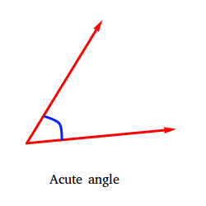
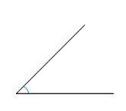
Types of Angles
3) An Acute Angle has a measure between 0° and 90°.
A very important Acute Angle is the 45° angle. It is the measure of half of a Right Angle.

Slide 5
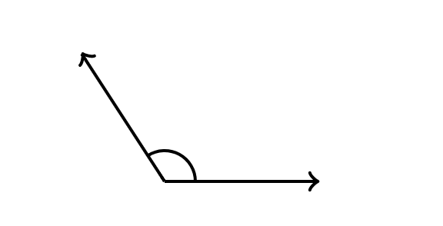
Types of Angles
4) An Obtuse Angle has a measure between 90° and 180°

Slide 6
Practicing Estimation
You will need a straight edge. Work together with the person sitting next to you to complete the following task:
Use the straight edge to draw an angle.
Have your partner:
Use the 45°, 90°, and 180° angles as reference angles to estimate the size of the angle.
Record the estimate.
Trade roles and continue until you have 6 different angles. Try to make angles that are acute, right, and obtuse.
Order the estimates from least to greatest

Slide 7
Practicing Estimation

Slide 8
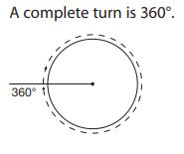
What about Angles Greater than 180°?
We know that a Straight Angle is equal to a measure of 180°
Knowing an Angle is the amount of “turn”, we can think of 180° as half way to creating a Complete Turn
If this is the case, then a Complete Turn, or Rotation, is equal to 360°

Slide 9
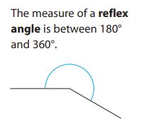
What about angles greater than 180°?
We know that a Reflex Angle is greater than a Straight Angle
Since this is the case, a Reflex Angle is any angle that is between 180° and 360°

