Slide 1
Introduction to Angles
Mr. Murphy – Grade 6 Math

Slide 2
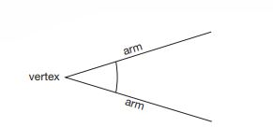
What is an Angle?
Key Words:
Arm: Simply a line. Two arms are required to make an angle
Vertex: The point where two Arms meet (intersection point)
Angle: The amount of “turn” between two Arms about the Vertex
There are three main components to creating an angle:
Arm
Vertex
An Angle can be thought of as the amount of “turn” between two Arms about the Vertex

Slide 3
A Real-Life Example
A great example of where you can find an angle is on an analogue clock.
The hands of the clock can thought of as Arms which intersect to create a Vertex.
The amount of turn between the two arms is an Angle.
Can you think of any other places where you can find an angle?

Slide 4
Types of Angles
Right Angle:
Straight Angle:

Slide 5
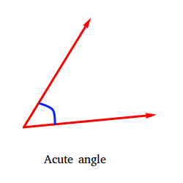
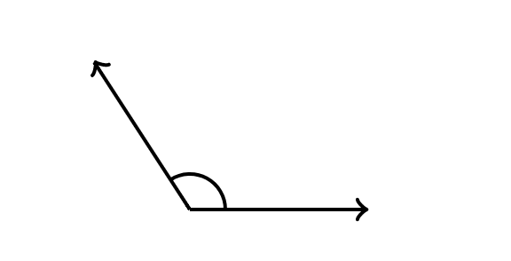
Types of Angles
3) Acute Angle: An angle less than a Right Angle
4) Obtuse Angle: An angle greater than a Right Angle, but less than a Straight Angle

Slide 6
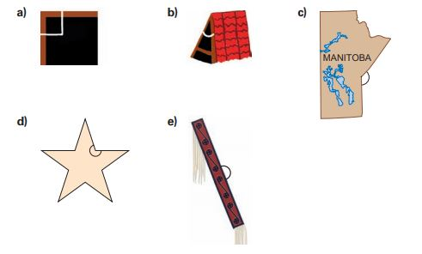
Practice
Name the following angles:

Slide 7
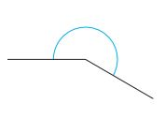
Types of Angles
5) Reflex Angle: An angle that is greater than a Straight Angle.

